Slide 1

Extraction of Regulatory obligations for Financial Institutions from Regulatory documents using NLP Techniques
Pradeep Narayanamoorthy
pradeep4@Illinois.edu

Slide 2
Problem Definition
Global Financial Institutions are required to be in compliance with local laws.
Compliance officers & Analysts need to keep track of evolving regulations on a daily basis.
If a particular regulation is deemed applicable to a firm – Compliance officers & Business Analysts need to define new Business Rules or the impact to current business rules due to the regulation.
Compliance officers & Analysts may have to read through hundreds of pages of regulatory document before coming to conclusion about the impact of the regulation. Also multiple personnel may be involved in extracting the rules in the regulation.
The above process is highly manual and prone to errors. Also in general the requirement definition task for a key impact regulation may run to several months before any actual effort is taken to build a solution.

Slide 3
NLP Based solution – Automation of Rule Extraction
In general it is observed that Regulatory documents contain Key Rule statements.
The Key Rule statements often are followed with specific Business rules or Operating Requirements & Reporting Requirements
Documents also contained other information such as Definitions of key terms & other Observations
The central idea is to extract the Key Rules along with Operating requirements & Reporting requirements
Approach:
Train a Document Classifier by labelling Phrases from the regulatory text as “Key Rule” or “TOC” or “Operating Requirement” ..etc..
Extract text content from a regulatory document using PyPDF2 module.
Use the trained classifier to label phrases from the document to be evaluated.
Data Clumping : From the labelled output, clump Co- Occurring Key Rules, Operating Requirements & Reporting Requirements.
Clumping of documents is performed based on document distance or feature distance measure. In this current implementation a distance of ‘7’ is used to clump rules together.
Once Rules are clumped together a Summarizer algorithm is applied to summarize each rule. Each summarized rule is written to a document summary.
The above document summary will contain all the key rules discussed in the regulatory document.

Slide 4

Regulatory Document Structure & Key Components
Table of Contents
Regulatory document
Background/Observations
In general it was observed that most of the regulatory documents provided a background information regarding the origination of the regulation. And also provide certain facts to support the need for such a regulation.
Definitions
It was also observed that most of the regulatory documents defined various terms used in the document. In general phrases such as following were observed ex: Derivatives clearing organization means
Key Rules
Every Regulatory document is structured around a few Key Rules or concepts either be it Restriction of Trading activity or Compliance requirements etc.. These rules based on study of regulations published by Fed & SEC seems to follow a specific structure ex: Permitted underwriting and market making-related activities. Key words such as Permitted, restricted etc. follow certain financial or related activity
Operational Requirements
It was also observed that every Key Rule in the document was generally followed up by certain requirements to satisfy the rule. This consisted of text statements spelling out the restrictions or providing business rules or compliance rules. It is generally observed that these Operation Requirements will be translated with in an organization into specific business rules to satisfy the regulatory obligations.
Reporting Requirements
Similar to the Operation Requirements observed, regulatory documents also contained Reporting requirements. Again reporting requirements contained specific textual structure.

Slide 5
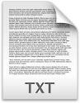
System Overview
Regulatory Document
Text Extraction
Text Categorization
Data Clumping
Rule Summarization
PYPDF2
Key Rule
Key Rule1
Rule 1 Summary
Operating Requirement
Operating
Requirement
Reporting Requirement
Document Summary - Rules
Extracted Rules
Reporting
Requirement
Key Rule2
Rule 2 Summary
Operating Requirement
Observations
Reporting Requirement
Definitions
Key Rule3
Operating Requirement
Rule 3 Summary
Reporting Requirement

Slide 6
Tools utilized in the current implementation
PYPDF2
Used for text extraction from regulatory document.
Text Unit for analysis/classification – Paragraph – Extracted by the following rule : its start is indicated by a new line and the end is the beginning of another new line without running to the next passage
Text Categorization
Support Vector Machine Classification implementation in Metapy Tool Kit. One of the key features of SVM is there is no parameter tuning required. Hence the algorithm can be utilized for multiple use cases with out changing implementation method.
SUMY Text Summarizer
Text Summarization using Latent Semantic Analysis was utilized for summarization of Key Rule Data Clumps. A package called SUMY was utilized to perform the text summarization. LSA was chosen as LSA requires no prior training or tuning.
https://github.com/miso-belica/sumy

Slide 7
Using the Tool
Navigate to git hub link : https://github.com/iamcoderz/Regulatory_obligation_extraction
Download or clone the repository to your local
Navigate to url : https://www.occ.treas.gov/news-issuances/news-releases/2013/nr-ia-2013-186b.pdf
and save the Volcker regulation pdf with in the cloned repository ( You can download any regulatory document and save to the repository location)
Ensure following folders/Files are available in the folder:
Regulatory_obligation_extraction : Main folder
Regulatory_obligation_extraction/crf
Regulatory_obligation_extraction/parser
Regulatory_obligation_extraction/perceptron-tagger
Regulatory_obligation_extraction/training
createconfig.py
createcorpusconfig.py
labeloutput.py
labeloutput_new.py
lemur-stopwords.txt
processpdf.py
Regsearch.py
Summarizer.py
training-config.toml
If you encounter issue with the parser or perceptron-tagger or crf folder contents please download the latest version from the following link:
https://github.com/meta-toolkit/meta/releases

Slide 8



Using the Tool contd..
Download the package files from GitHub - https://github.com/iamcoderz/Regulatory_obligation_extraction
and save to local drive
Run the processpdf.py file through Command line
Place the Regulatory document in the Project files folder & Provide path as shown below
Provide the regulatory pdf document file name for processing

Slide 9
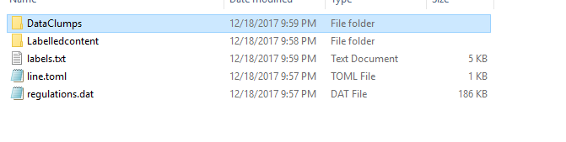
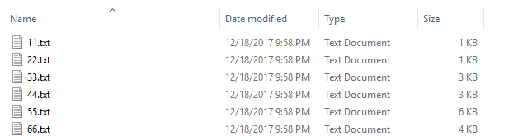
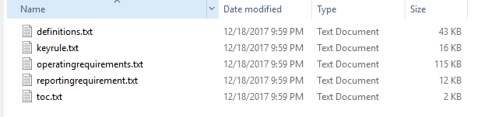

Using tool Contd..
Following files & folders get created during processing
The folder DataClumps contains files containing clumps of data (labelled as Key Rule, Operating requirement & Reporting Requirement)t which are separated by degree of separation < 7
Labelled Content folder contains files which all text from the regulatory document separately filed per their label
Labels.txt – file contains the sequence of all labels assigned to the regulatory document being analyzed
Regulations.dat – is the text content from the regulatory document.
Line.toml – is a config file created to analyze regulatory text.
Data Clumps
Summary Document
Labelled Content

Slide 10
Future Work
Integration of web crawler program
Integrate the tool with a Web Crawler that is able to crawl regulators web portals for new regulatory documents & automatically extract regulatory obligations
Compliance Rule book updation/Alert generation
The tool can be improved by linking the package with the firm’s rule book. The tool would be able to reconcile regulatory obligations with rule book by using a similarity function and throw out alerts where obligations do not have any corresponding rule in the compliance rulebook
Rule difference per
Jurisdiction
Key Rules that are similar across jurisdictions can be analyzed for similarity in their operational or reporting requirements. Any differences can be highlighted to Compliance officers/Analysts for further action.

